Slide 1
CS 316: Introduction to Deep Learning
Multi Layer Perceptron
Week 7
Dr Abdul Samad

Slide 2
Lecture Outline
Affine Transformation
Limitation of Linear Models
Hidden Layers
Linearity to Non-Linearity
Activation Functions
ReLU
Sigmoid
Tanh

Slide 3
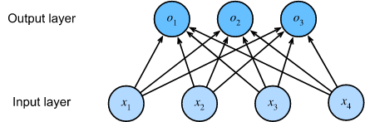
Affine Transformation
In SoftMax regression, inputs are directly mapped to the outputs by a single affine transformation, followed by SoftMax activation.
If the labels are truly related to the input data via an affine transformation, this approach is sufficient.
However, linearity in affine transformations is a strong assumption.
Figure taken from Affine Transformation

Slide 4
Limitation of Linear Models
Linearity implies the weaker assumption of monotonicity i.e., any increase in our feature must either always cause an increase in our model’s output, or always cause a decrease in our model’s output.
For example, when predicting whether a person would repay a loan, we could expect that an applicant with higher income would always be more likely to repay than one with a lower income.
The relationship is monotonic but not linear. One way to make linearity more plausible is to preprocess the data i.e., take logarithm of income as a feature.
However, when classifying images of cats and dogs, the issue cannot be resolved by a simple preprocessing fix.
We can handle these limitations of linear model by incorporating one or more hidden layers.

Slide 5
Incorporating Hidden Layers
We can use deep neural networks to jointly learn a representation via hidden layers and a linear predictor that acts on that representation using observational data.
The easiest way to incorporate hidden layers is to stack many fully-connected layers on top of each other.
Each layer feeds into the layer above it, until we generate outputs.
The first L – 1 layer's act as our representation, and the final layer as our linear predictor.
This architecture is called Multi-Layer Perceptron (MLP)

Slide 6
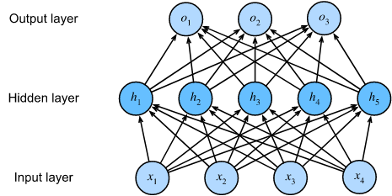
Multi Layer Perceptron - Example
The MLP has 4 inputs, 3 outputs, and its hidden layer contains 5 hidden units.
The input layer does not involve any calculations, producing outputs with this network requires computations for both the hidden and output layers. Thus, the number of layers is 2.
Every input influences every neuron in the hidden layer, and each of these in turn influence every neuron in the output layer.
Figure taken from Multi Layer Perceptron

Slide 7
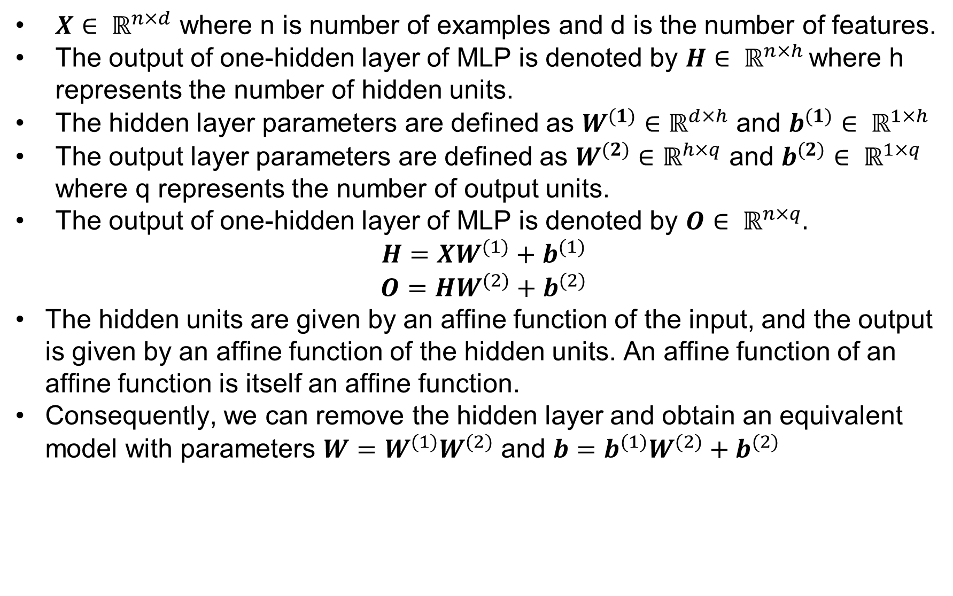
Equivalence of Linear Models
$X∈ ℝ^{n×d}$ where n is number of examples and d is the number of features.
The output of one-hidden layer of MLP is denoted by $H∈ ℝ^{n×h }$where h represents the number of hidden units.
The hidden layer parameters are defined as $W^{(1)}∈ℝ^{d×h}$ and $b^{(1)}∈ ℝ^{1×h}$
The output layer parameters are defined as $W^{(2)}∈ℝ^{h×q}$ and $b^{(2)}∈ ℝ^{1×q}$ where q represents the number of output units.
The output of one-hidden layer of MLP is denoted by $O∈ ℝ^{n×q}.$
$$H=XW^{(1)}+b^{(1)}$$
$$O=HW^{(2)}+b^{(2)}$$
The hidden units are given by an affine function of the input, and the output is given by an affine function of the hidden units. An affine function of an affine function is itself an affine function.
Consequently, we can remove the hidden layer and obtain an equivalent model with parameters $W=W^{(1)}W^{(2)}$ and $b=b^{(1)}W^{(2)}+b^{(2)}$

Slide 8
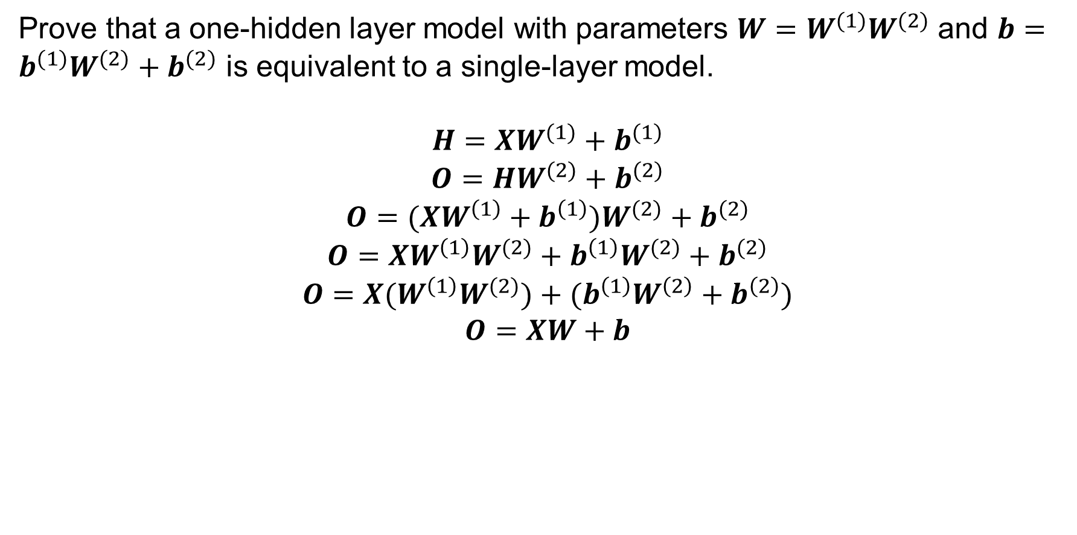
Equivalence of Linear Models - Example
Prove that a one-hidden layer model with parameters $W=W^{(1)}W^{(2)}$ and $b=b^{(1)}W^{(2)}+b^{(2)}$ is equivalent to a single-layer model.
$$H=XW^{(1)}+b^{(1)}$$
$$O=HW^{(2)}+b^{(2)}$$
$$O=(XW^{\left(1\right)}+b^{\left(1\right)})W^{(2)}+b^{(2)}$$
$$O=XW^{\left(1\right)}W^{(2)}+b^{\left(1\right)}W^{(2)}+b^{(2)}$$
$$O=X{(W}^{\left(1\right)}W^{(2)})+(b^{\left(1\right)}W^{\left(2\right)}+b^{\left(2\right)})$$
$$O=XW+b$$

Slide 9
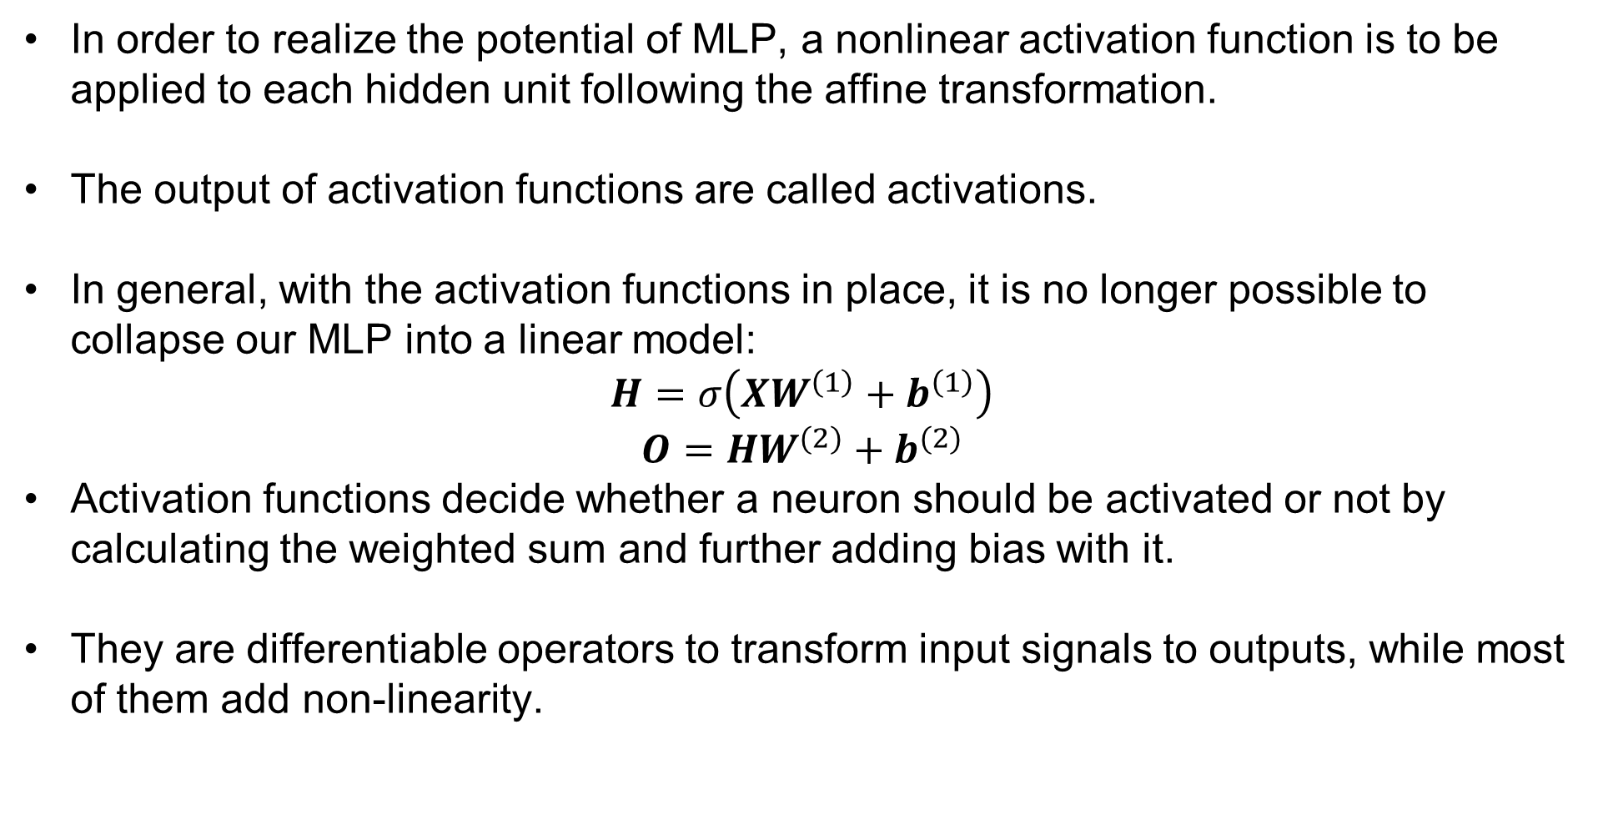
Activation Functions
In order to realize the potential of MLP, a nonlinear activation function is to be applied to each hidden unit following the affine transformation.
The output of activation functions are called activations.
In general, with the activation functions in place, it is no longer possible to collapse our MLP into a linear model:
$$H=σ\left(XW^{\left(1\right)}+b^{\left(1\right)}\right)$$
$$O=HW^{(2)}+b^{(2)}$$
Activation functions decide whether a neuron should be activated or not by calculating the weighted sum and further adding bias with it.
They are differentiable operators to transform input signals to outputs, while most of them add non-linearity.

Slide 10
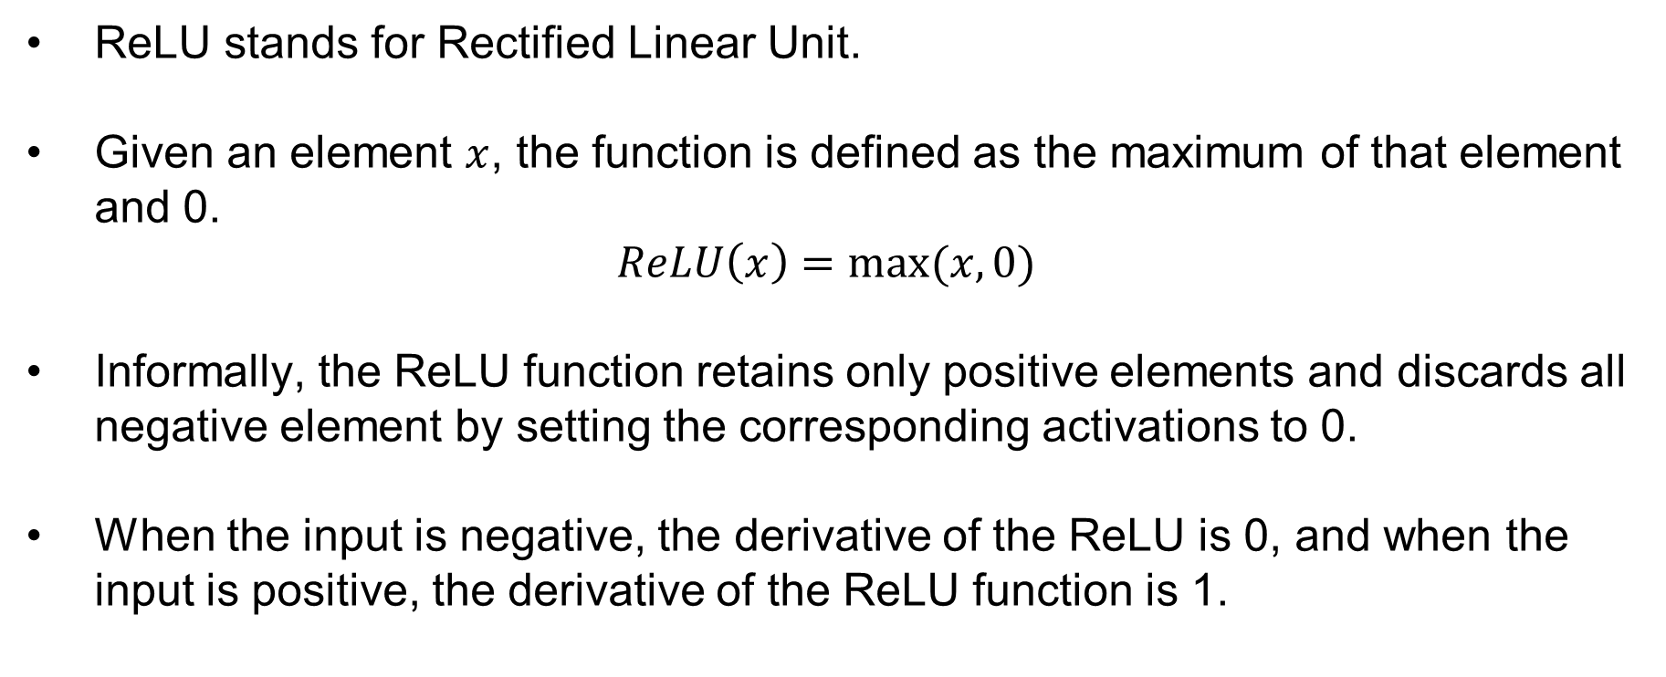
Activation Functions - ReLU
ReLU stands for Rectified Linear Unit.
Given an element $x$, the function is defined as the maximum of that element and 0.
$$ReLU\left(x\right)=max⁡(x,0)$$
Informally, the ReLU function retains only positive elements and discards all negative element by setting the corresponding activations to 0.
When the input is negative, the derivative of the ReLU is 0, and when the input is positive, the derivative of the ReLU function is 1.

Slide 11
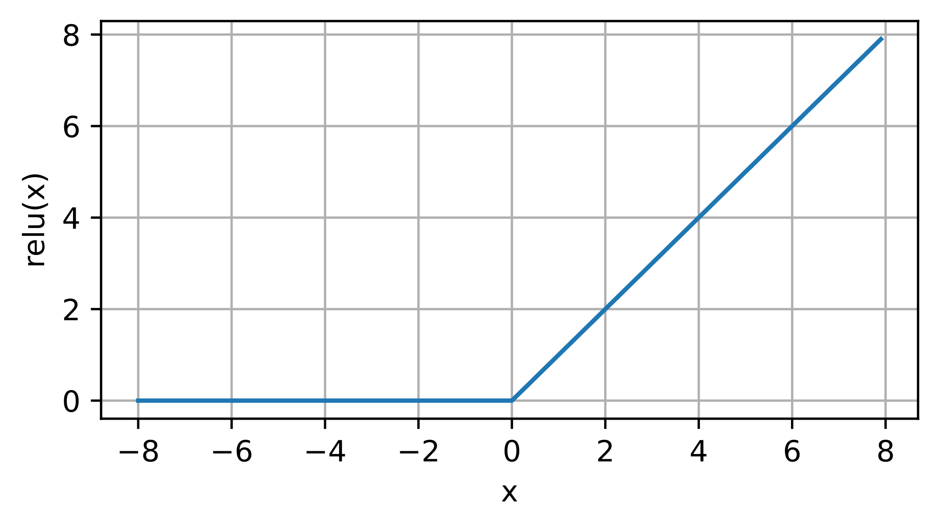
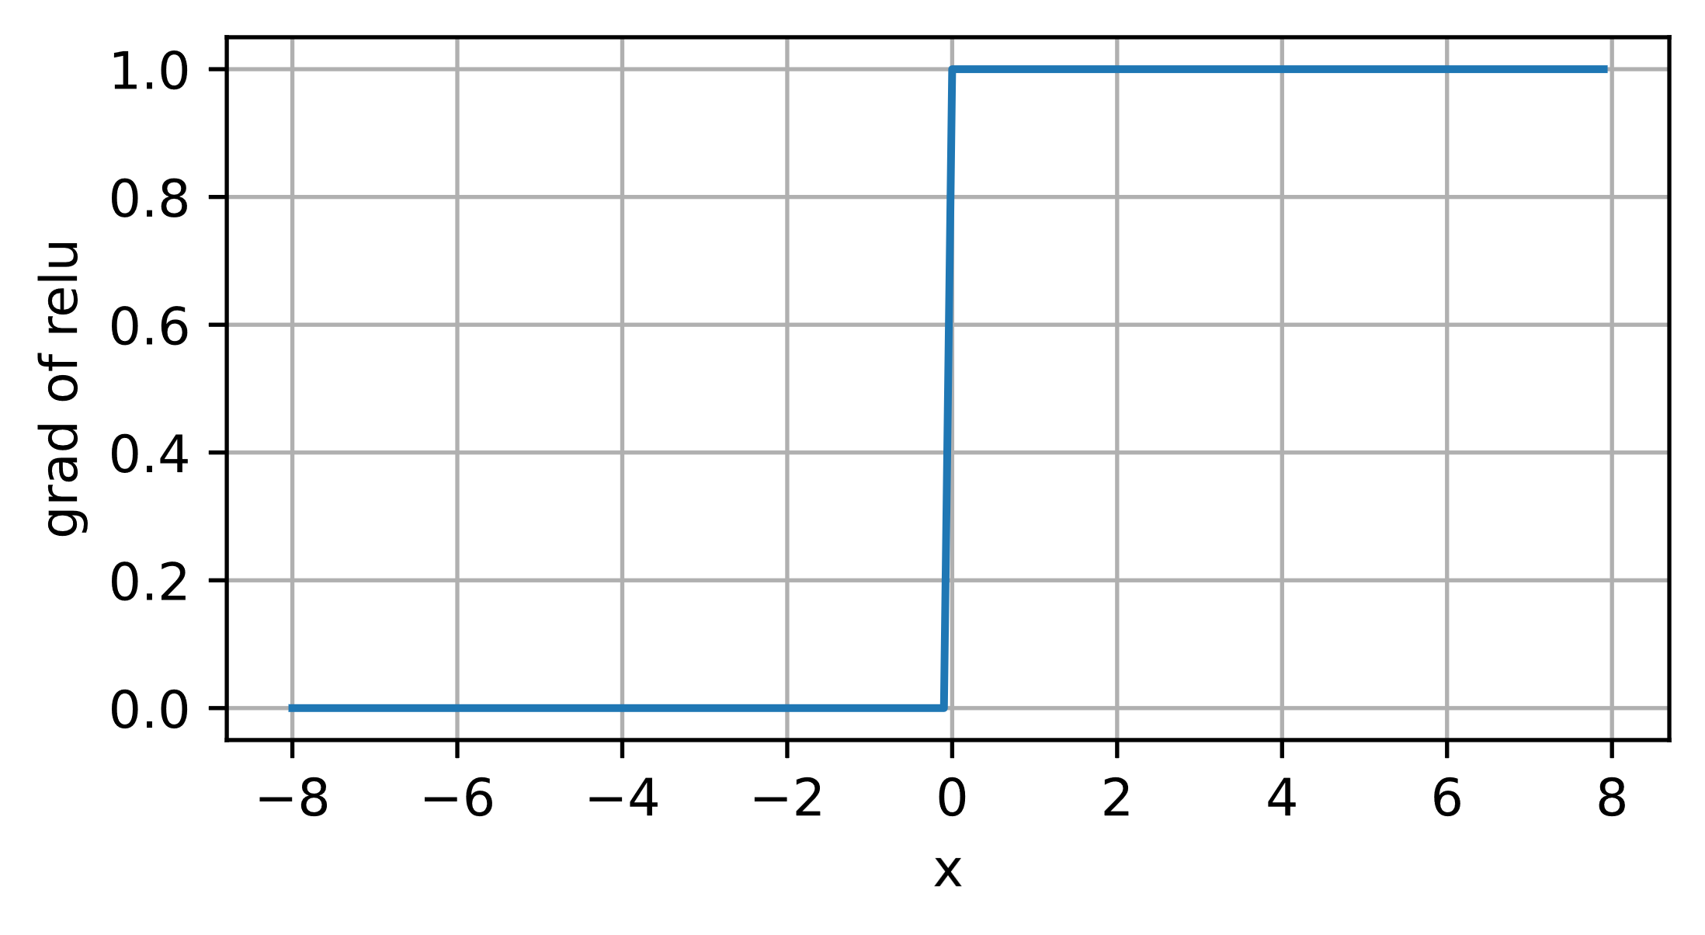
Activation Functions - ReLU
The following is the graph of the ReLU function and its derivative:
Figures taken from ReLU, Grad ReLU

Slide 12
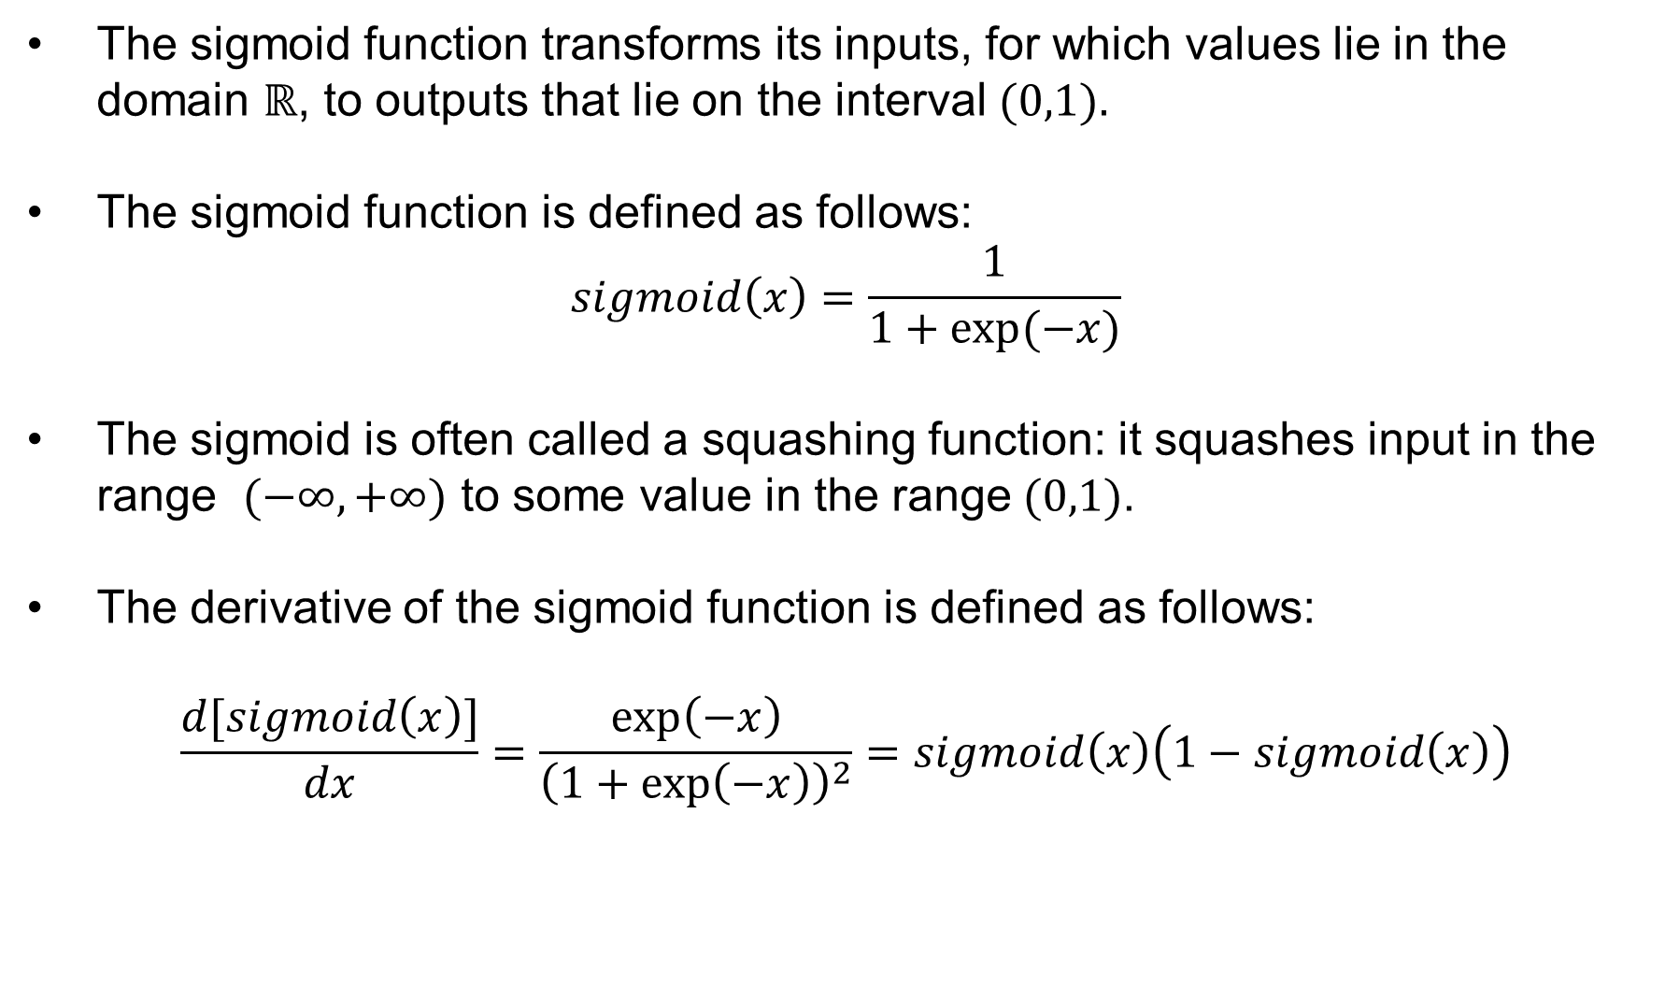
Activation Functions - Sigmoid
The sigmoid function transforms its inputs, for which values lie in the domain $ℝ$, to outputs that lie on the interval $(0,1).$
The sigmoid function is defined as follows:
$$sigmoid\left(x\right)=\frac{1}{1+exp⁡(−x)}$$
The sigmoid is often called a squashing function: it squashes input in the range $(−∞,+∞)$ to some value in the range$(0,1)$.
The derivative of the sigmoid function is defined as follows:
$$\frac{d[sigmoid\left(x\right)]}{dx}=\frac{\exp\left(−x\right)}{{\left(1+\exp\left(−x\right)\right)}^{2}}=sigmoid\left(x\right)\left(1−sigmoid\left(x\right)\right)$$

Slide 13
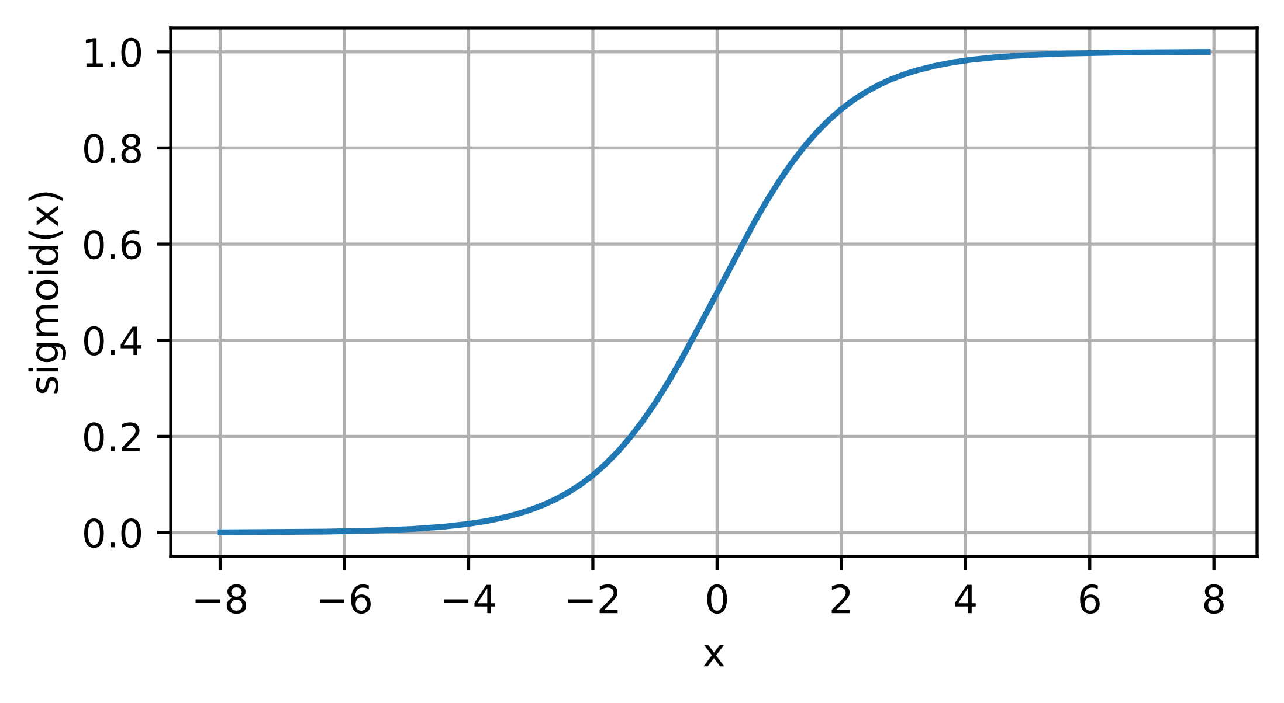
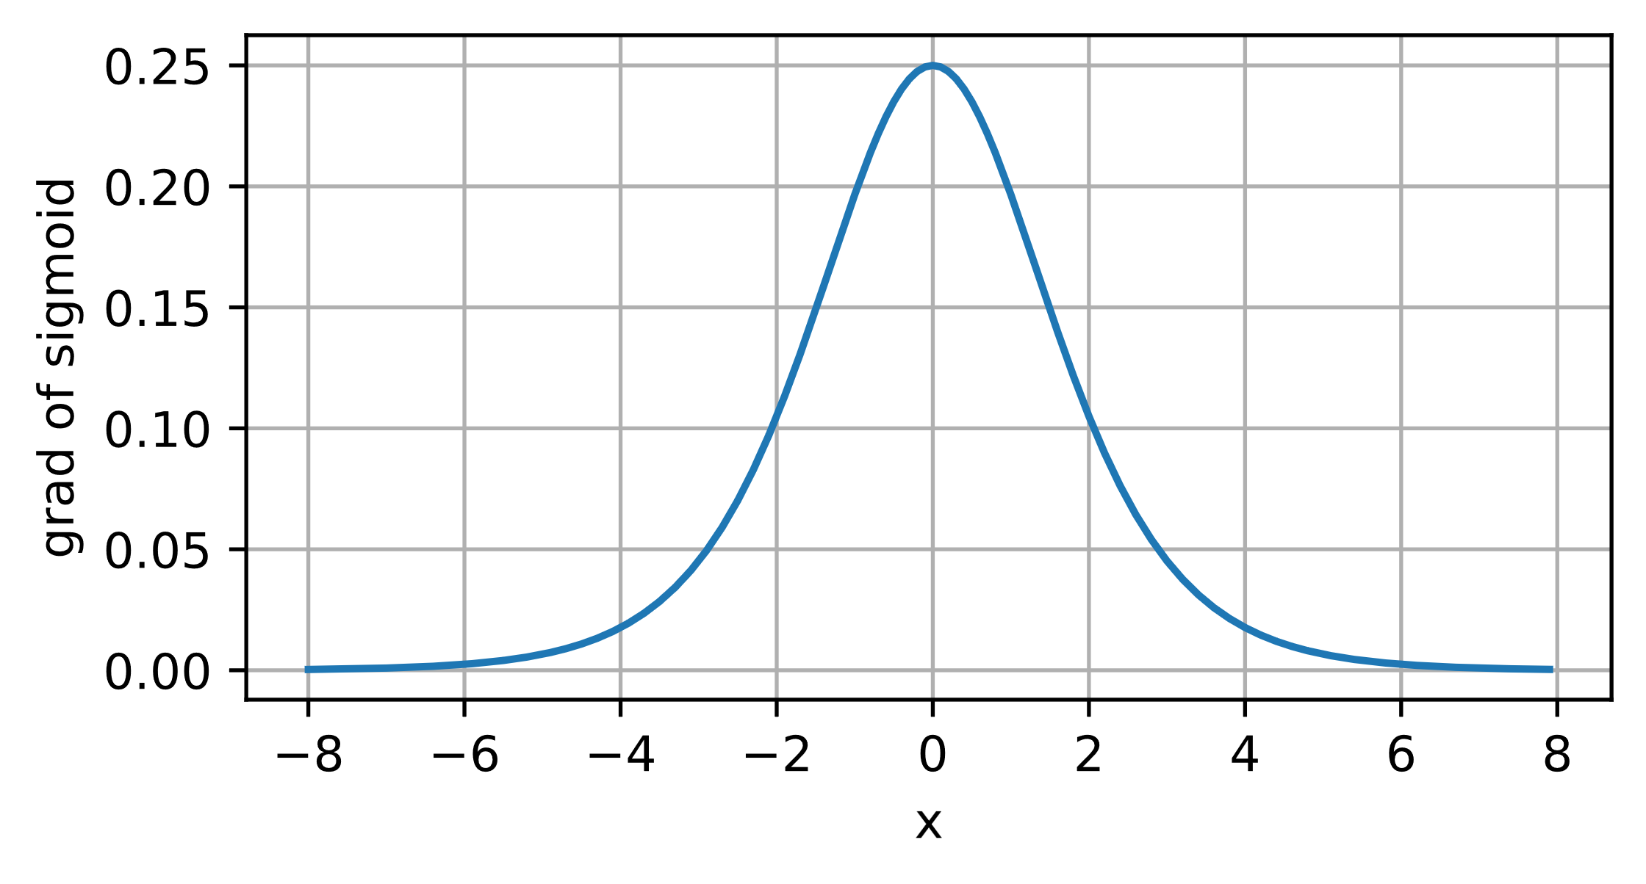
Activation Functions - Sigmoid
The following is the graph of the Sigmoid function and its derivative:
Figures taken from Sigmoid, Grad Sigmoid

Slide 14
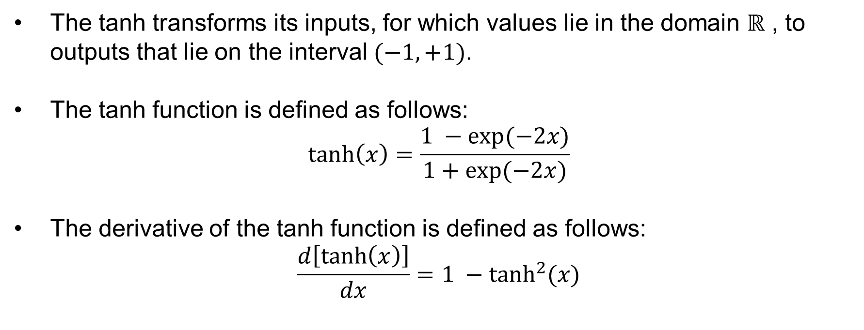
Activation Functions - Tanh
The tanh transforms its inputs, for which values lie in the domain $ℝ$ , to outputs that lie on the interval $(−1,+1)$.
The tanh function is defined as follows:
$$\tanh\left(x\right)=\frac{1 −exp⁡(−2x)}{1+\exp{(−2x)}}$$
The derivative of the tanh function is defined as follows:
$$\frac{d\left[\tanh\left(x\right)\right]}{dx}=1 −\tanh^{2}{(x)}$$

Slide 15
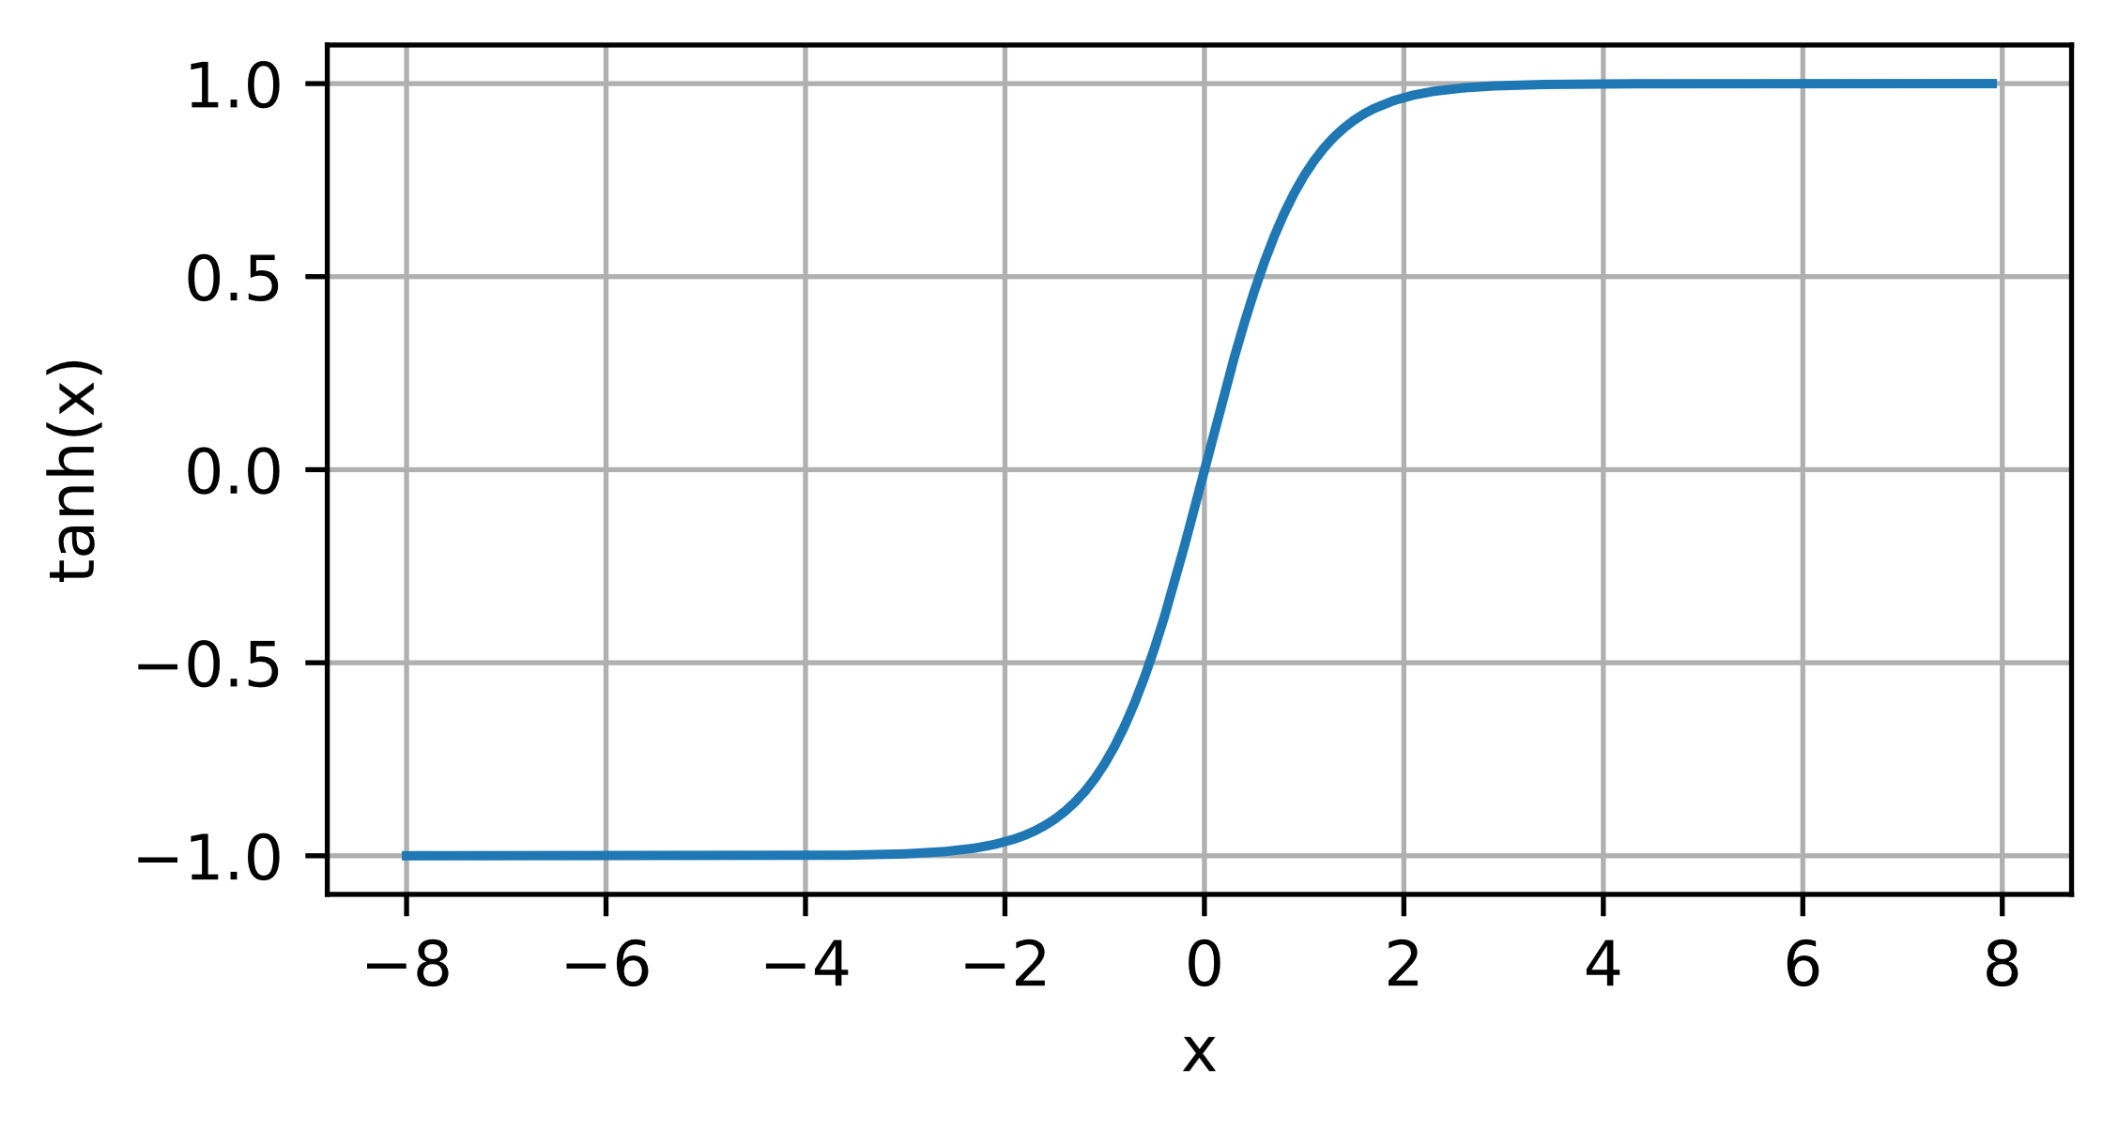
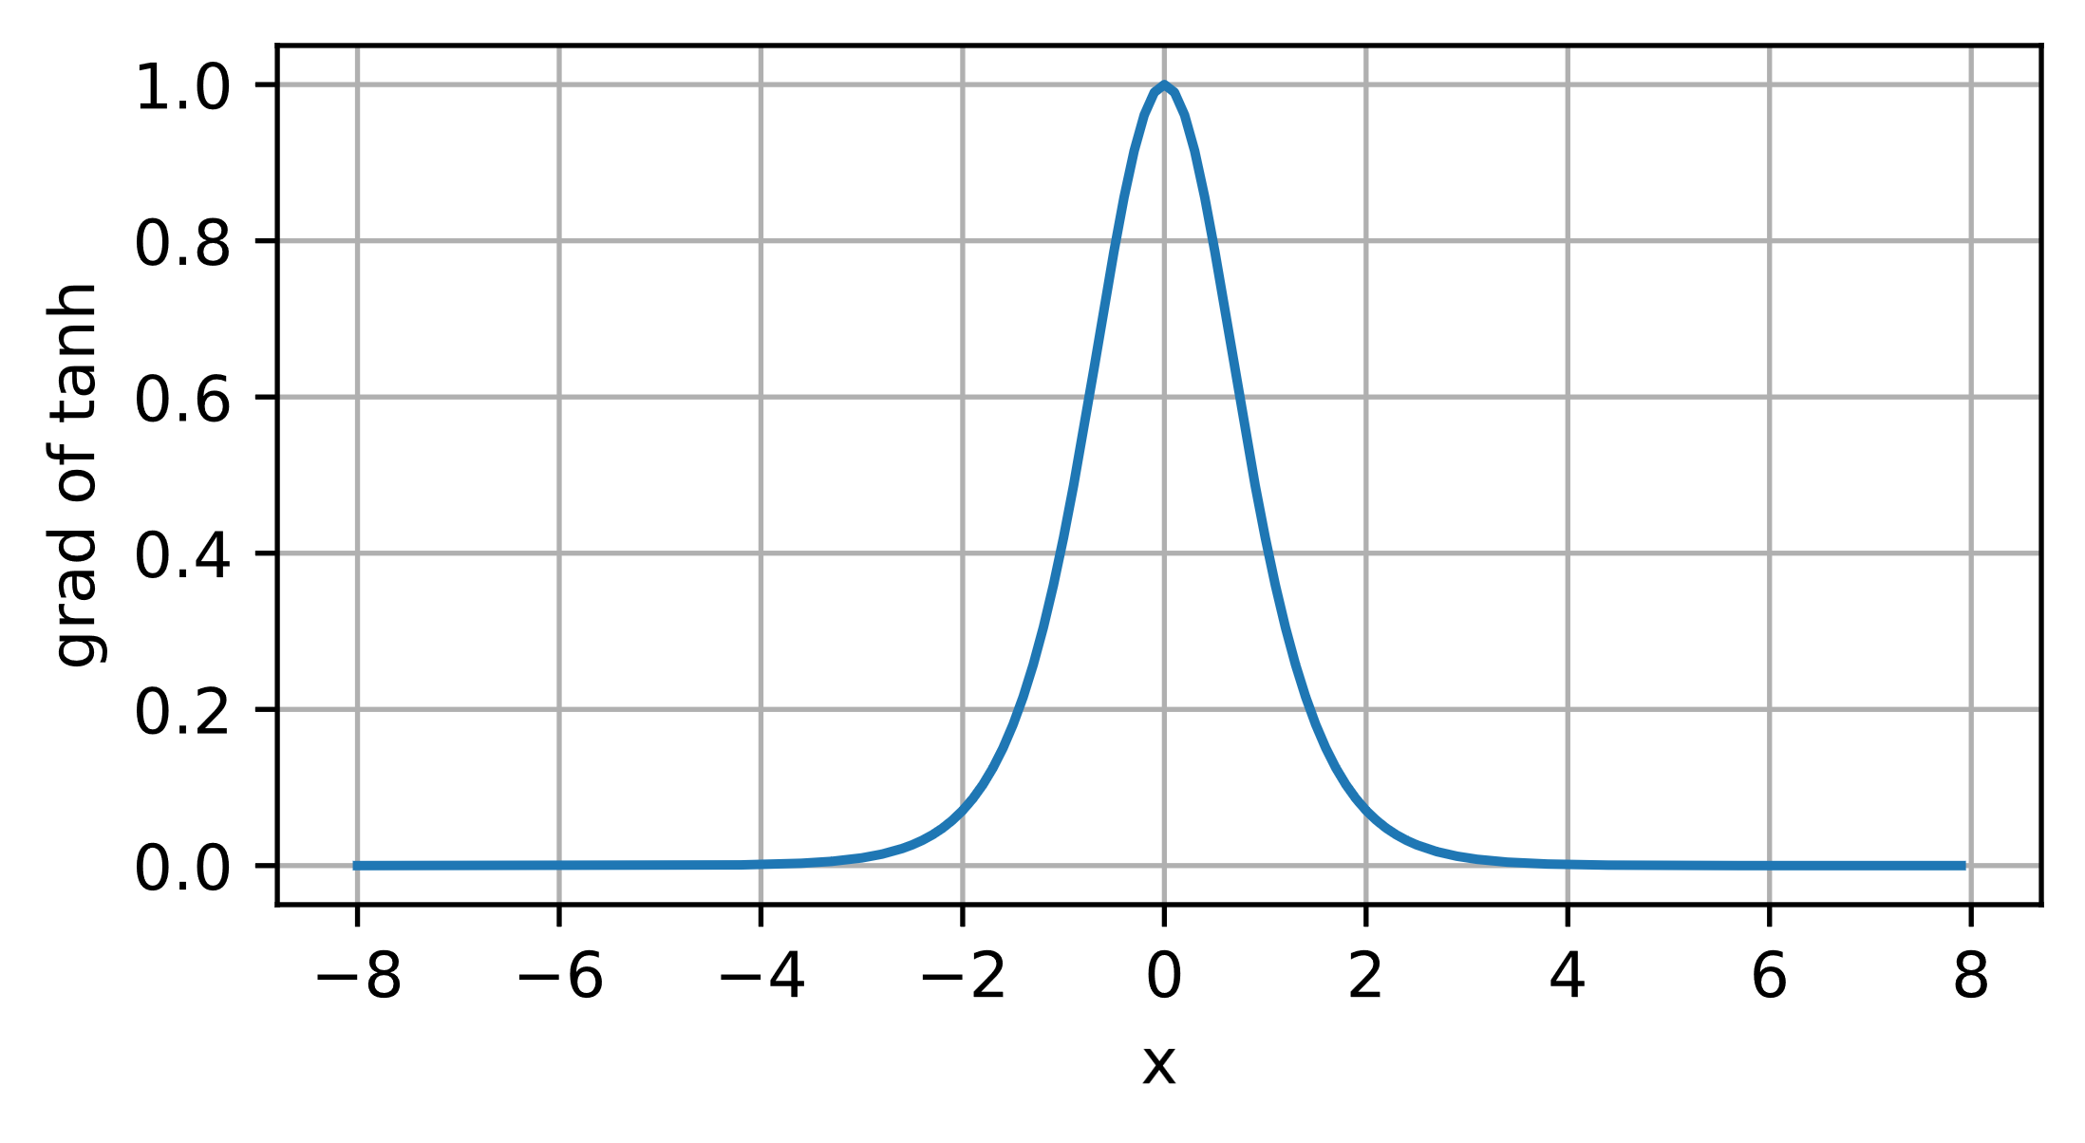
Activation Functions - Tanh
The following is the graph of the Tanh function and its derivative:
Figures taken from Tanh, Grad Tanh

Slide 16
References
https://d2l.ai/chapter_multilayer-perceptrons/index.html

